Slide 1
E-commerce Websites Product Ratings vs. Reviews
Jiaxiang Zhu, Ryan Anderson
Siyao Cai, Sean Lu

Slide 2
Motivation:
Purchasing things online has become easier
Many different categories of products are available:
Beauty
Electronics
Clothing
etc...
Normally, customers like to check product ratings before purchasing products

Slide 3
Potential Issues with the Rating System:
However, ratings are not always accurate...
Can the ratings adequately reflect the sentiment of the customers’ reviews?
A product could have an overall high rating alongside some extremely bad reviews.
Is the product actually good or bad?
We want to analyze samples of ratings / reviews of a few E-commerce websites to answer the these questions.

Slide 4
What Are We Looking for During Data Analysis?
In general, is the current rating system of E-Com websites working as intended?
What are some of the flaws that we find during our data analysis?
How can we possibly improve the current system, for a more accurate and better representation of the customer sentiment?

Slide 5
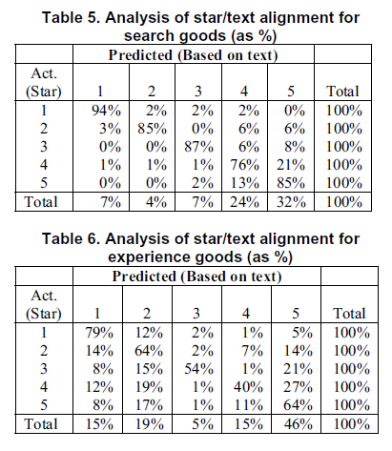
Previous Works:
Online star ratings vs. review content
Data set: 1734 reviews from Amazon
Classification model: TagHelper (supervised)
Rating-review misalignment occurs more often in experience goods
Misalignment occurs more often in reviews with high star rating.
Why Aren’t The Stars Aligned?
An analysis of Online Review Content and Star Ratings.
Mudambi et al. 2014

Slide 6
Data Analysis Method:
Ran a Linux server with a MySQL DB
Using Python and Shell scripts to sort, query, and analyze raw review data
Generated sentiment scores (VADER) based on reviews samples
Used SQL queries to generate relevant statistics, then create graphs with excel

Slide 7
Amazon Data Set:
Used data set from UCSD (Julian McAuley)
Original data set had millions of reviews
Sampled 100 products from each of the 7 categories along with all the associated reviews
http://jmcauley.ucsd.edu/data/amazon/
Beauty | Clothing, Shoes, Jewelry | Electronics | Movies and TV | Office Products | Sports and Outdoors | Video Games
100 | 100 | 100 | 100 | 100 | 100 | 100

Slide 8
Potential Issues with Amazon Data Set:
Amazon data only goes until 2014
Walmart data is from October 2019
Samples from Amazon dataset are clustered in the beginning of the alphabet

Slide 9
Walmart Data Set:
To compare with the Amazon dataset, we produced our own dataset from Walmart.com
The dataset was collected by scraping several pages within the same categories as the Amazon dataset
The goal was to collect 100 products per category to match the Amazon set
However, the number of products varied per category
Beauty | Clothing, Shoes, Jewelry | Electronics | Movies and TV | Office Products | Sports and Outdoors | Video Games
99 | 106 | 100 | 109 | 80 | 81 | 106

Slide 10
Potential Issues with Walmart Data Set:
Walmart dataset was scraped from website
Website is sorted by best-sellers
This resulted in Walmart having far more reviews per product
62k reviews from Walmart in 681 products
15k reviews from Amazon in 700 products
May have effect on rating and review sentiment

Slide 11
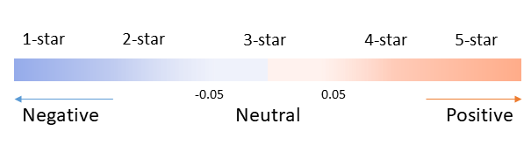
Sentiment Analysis:
Valence Aware Dictionary and sEntiment Reasoner (VADER)
Open-source sentiment analysis tool
Lexicon and rule-based sentiment analysis tool specifically attuned to sentiments expressed in social media and multiple domains
-1.0 ~ -0.6 -0.6 ~ -0.2 -0.2 ~ 0.2 0.2 ~ 0.6 0.6 ~ 1.0
Hutto, C.J. & Gilbert, E.E. (2014). VADER: A Parsimonious Rule-based Model for Sentiment Analysis of Social Media Text. Eighth International Conference on Weblogs and Social Media (ICWSM-14). Ann Arbor, MI, June 2014.

Slide 12
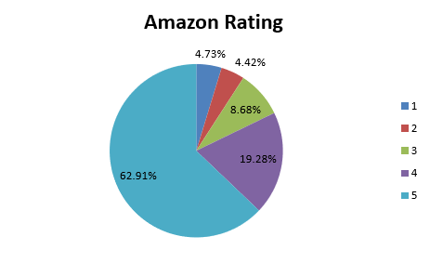
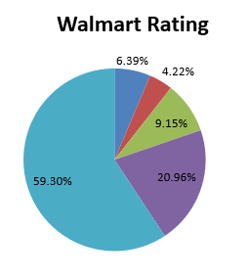
Ratings Comparison:
General distribution between sites is similar
Majority of ratings in 4 and 5 stars

Slide 13
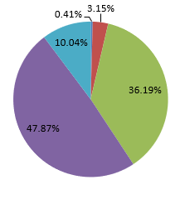
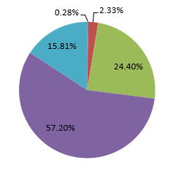
Sentiment Comparison:
Distribution between sites is similar again
Majority in 3 and 4 stars
1 and 2 stars are negligible
Walmart has more positive sentiment
More percentage in higher ratings, less in lower ratings
Amazon Sentiment Walmart Sentiment

Slide 14
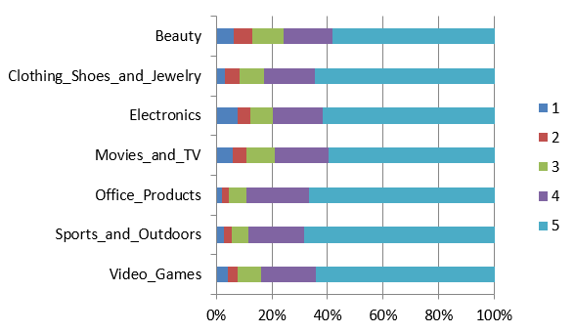
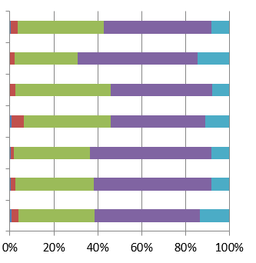
Rating/Sentiment by Category Amazon:
Rating majority in 4 and 5
Sentiment majority in 3 and 4
Rating Sentiment

Slide 15
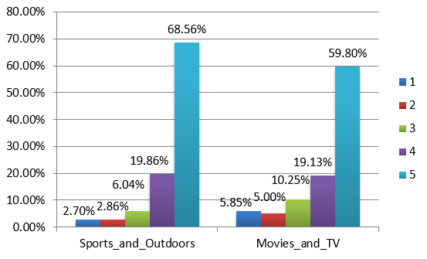
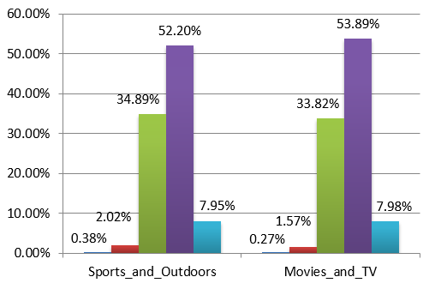
Example Categories Amazon:
Sentiment results are equal
Movies have worse ratings overall
Rating Sentiment

Slide 16
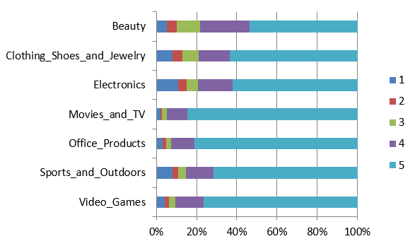
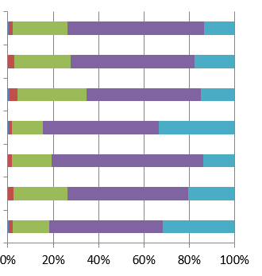
Rating/Sentiment by Category Walmart:
Same as Amazon
Rating majority in 4 and 5
Sentiment majority in 3 and 4
Rating Sentiment

Slide 17
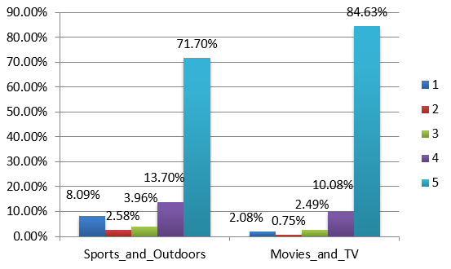
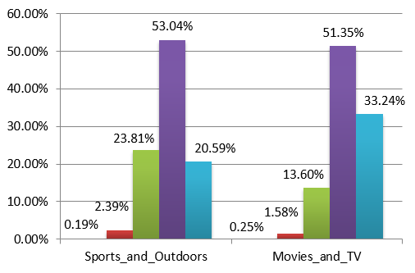
Example Categories Walmart:
Movies are higher in both rating and sentiment
Very few ratings that are not 5 stars
Almost no 1 or 2 star sentiment ratings
Rating Sentiment

Slide 18
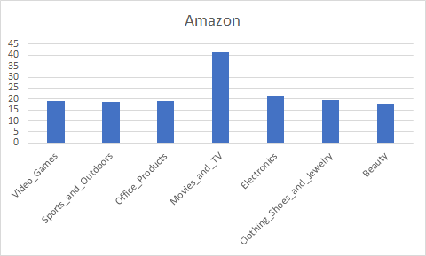
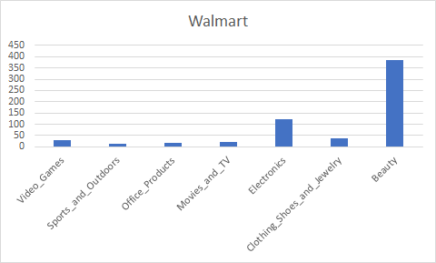
Reviews per Product Type:
Amazon has the highest rate of reviews in Movies and TV
Walmart has the highest rate of reviews in Beauty

Slide 19
Special Cases (1):
“Today’s version of this knife doesn't come even in thin plastic container-it comes in only thin paper box. The shiny handle material on mine was all scratched. The distributors of Swiss Army knife here in States got a bit cheap on its presentation of a fine knife.”
—Sentiment score: 0.149 (3) Rating: 2
“I bought it because it was cheaper than buying the original version which it is identical to except for item placements…”
— Sentiment score: 0.3182 (4) Rating: 1

Slide 20
Special Cases (2):
“This film was moving, to the edge of pathetic sympathy for this girl, good acting and great writing, but too dark and sad for my liking, however, others will love it I am sure.”
— Sentiment score: 0.9011 (5) Rating: 2
“I use a lot of labels to print scannable barcodes, I have tried some other brands with 1/3 of the price I pay for the Avery brand, but the quality was not good, plus the paper was too glossy, I had a lot of complaints about the labels that can not be read by the scanner, had to switch back to Avery labels and all the complaints disappeared. “
— Sentiment score: -0.9146 (1) Rating: 5

Slide 21
Insights:
Overall star rating is not sufficient to tell the whole story
Price, shipping, packaging all have impact on the rating of the product
For experience goods, customer ratings can be very subjective
The boundary between 4-star and 5-star is not always clear
Vader sentiment analysis can be improved by adding different weight to past tense and present tense

Slide 22
Improvement to the Rating Systems (1):
Both sites have issues with the general rating
Separate the general rating into different categories
Different potential rating categories for different types of products
Product Rating
Shipping Rating
Package Rating
Price Rating
General Rating

Slide 23
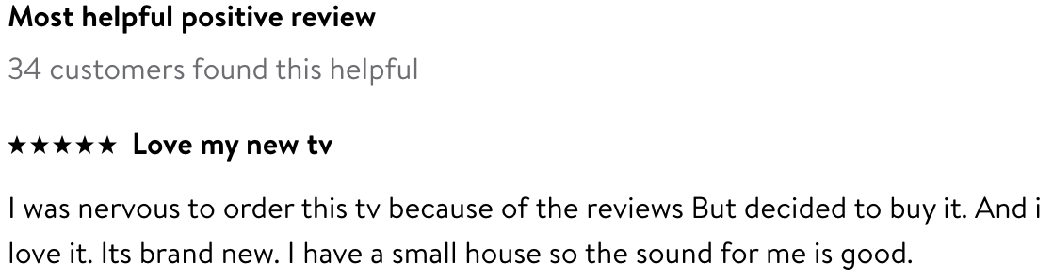
Improvement to the Rating Systems (2):
Both sites allow users to rate how helpful the reviews are
Walmart has a more “helpful” feature than Amazon with the most helpful positive/negative reviews
A potential improvement is to weight the overall ratings based on how helpful the reviews are
Notes:
Amazon has this feature as well. So why walmart wins over amazon?

Slide 24
Conclusion (1):
We have analyzed 77k rating / review data samples from E-Commerce websites such as Amazon and Walmart
Both rating systems could not accurately represent the product. There are large gaps between the ratings and the actual review texts by users
Both rating systems have flaws which could provide subjective / biased opinions to users

Slide 25
Conclusion (2):
Our data showed similar results to the referenced paper.
Rating-review misalignment occurs more often in experience goods
Misalignment occurs more often in reviews with high star rating.
Our advantages over the reference paper
Independent sentiment analysis process (Vader vs TagHelper)
Much larger data set (77k vs. 1734)
Data from multiple e-commerce websites
Potential improvements to the current rating system

Slide 26
References:
[1] Mudambi, S. M., Schuff, D., & Zhang, Z. (2014, January). Why aren't the stars aligned? An analysis of online review content and star ratings. In 2014 47th Hawaii International Conference on System Sciences (pp. 3139-3147). IEEE.
[2] Hutto, C.J. & Gilbert, E.E. (2014). VADER: A Parsimonious Rule-based Model for Sentiment Analysis of Social Media Text. Eighth International Conference on Weblogs and Social Media (ICWSM-14). Ann Arbor, MI, June 2014.
[3] http://jmcauley.ucsd.edu/data/amazon/

Slide 27

Questions? … Thank you!

Slide 28
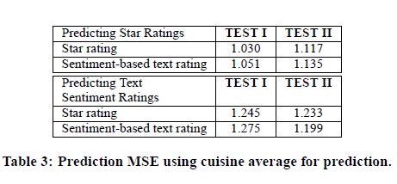
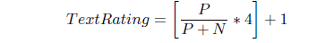
Other Previous Works:
Proposed new recommendation measures with textual component of user reviews
The text of a review is a better indicator of the sentiment of the review than the star rating.
Sentiment-based and regression-based text rating prediction.
Data set: 50000 restaurant reviews from New York
Beyond the Stars: Improving Rating Predictions using Review Text Content
Ganu et al. 2009

Slide 29
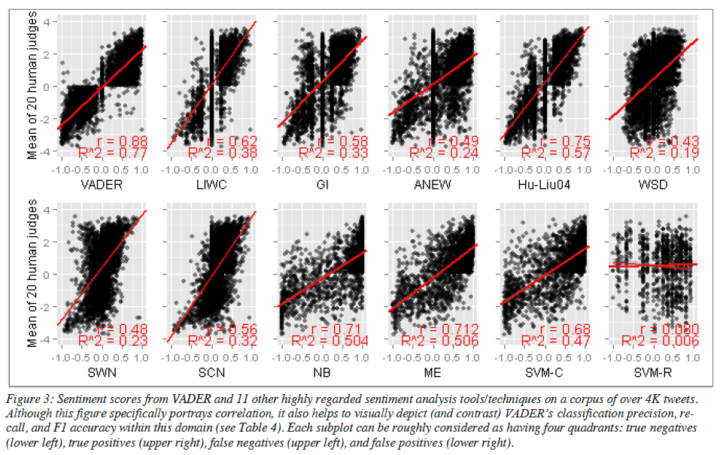
VADER Sentiment Analysis Details
Requires no training data
Constructed from generalized, valence-based, human-curated gold standard sentiment lexicon.
Hutto, C.J. & Gilbert, E.E. (2014). VADER: A Parsimonious Rule-based Model for Sentiment Analysis of Social Media Text. Eighth International Conference on Weblogs and Social Media (ICWSM-14). Ann Arbor, MI, June 2014.

